Slide 1


Slide 2

UNIT4: LEARNING WORLD
LESSON 2 : READING - SCHOOL PROJECT

Slide 3


Brainstorm
Brainstorm some good things about the school.
EXAMPLE:
+ It's a nice building.
+ There are good sports facilities.
+ The teachers are friendly.

Slide 4
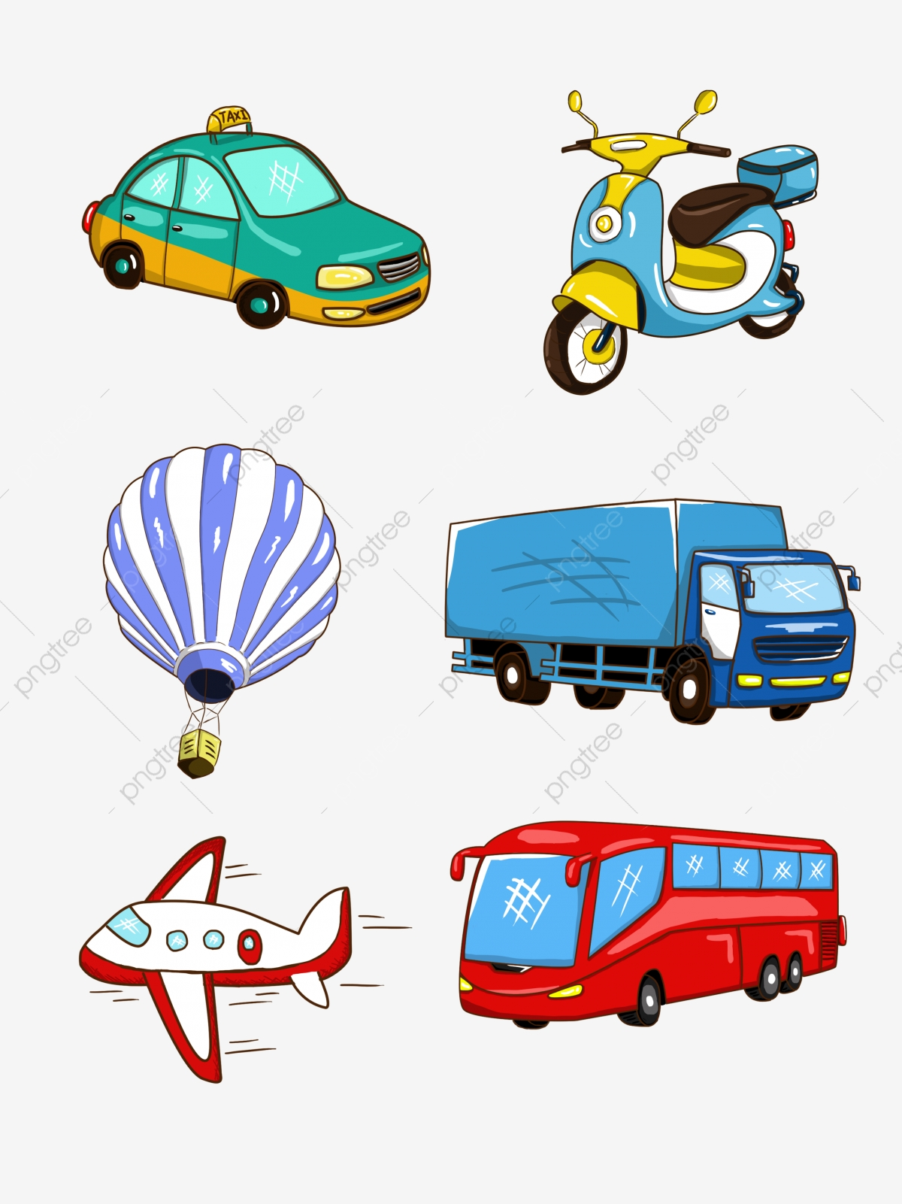
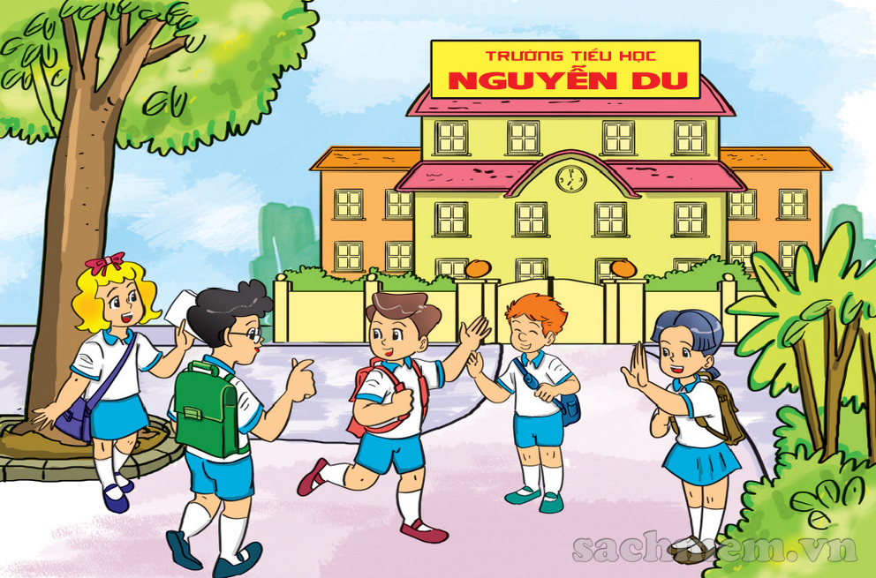
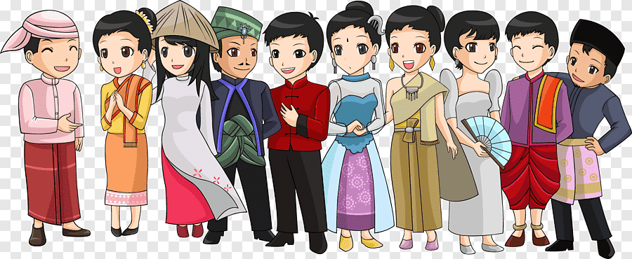
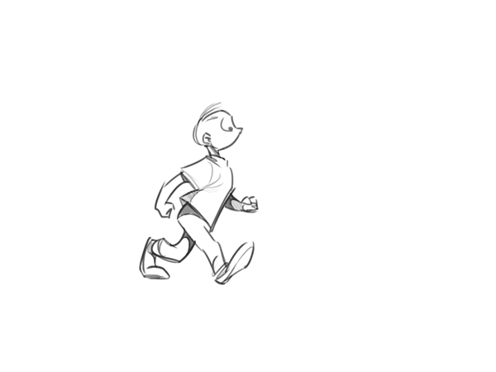

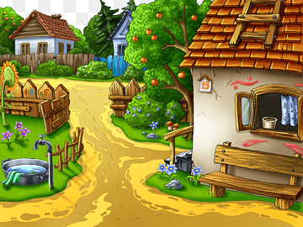
EXERCISE 1: Read the project. Where are the schools? Is the writer positive or negative about them
New words:
Traditional (adj) /trəˈdɪʃ.ən.əl/
Primary school (n) /ˈpraɪ.mə.ri ˌskuːl/
Transport (n) /ˈtræn.spɔːt/
Move (v) /muːv/
River (n) /ˈrɪv.ər/
Village (n) /ˈvɪl.ɪdʒ/

Slide 5
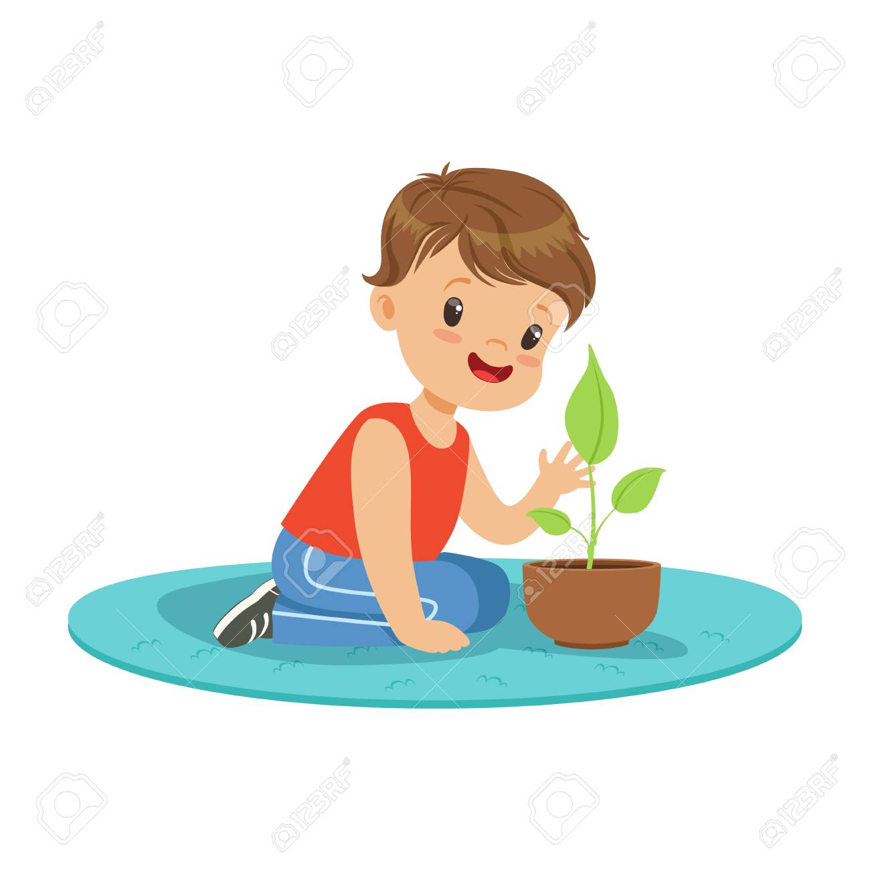

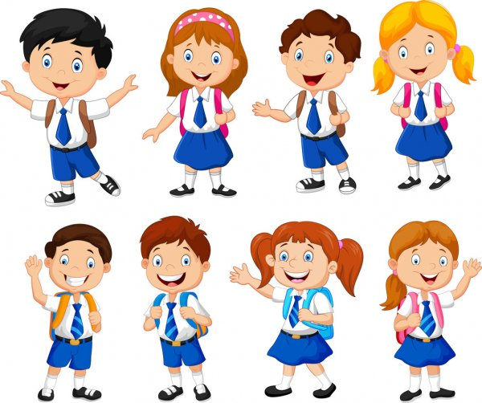




EXERCISE 1: Read the project. Where are the schools? Is the writer positive or negative about them
New words:
Private school (n) /ˌpraɪ.vət ˈskuːl/
Uniform (n) /ˈjuː.nɪ.fɔːm/
Practical (adj) /ˈpræk.tɪ.kəl/
Channel (n) /ˈtʃæn.əl/
Secondary school (n) /ˈsek.ən.dri ˌskuːl/
Musical instrument (n) /ˈmjuː.zɪ.kəl/ /ˈɪn.strə.mənt/

Slide 6
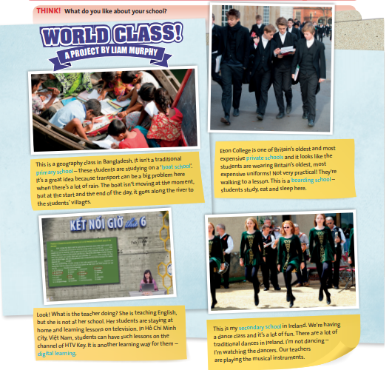
EXERCISE 1: Read the project. Where are the schools? Is the writer positive or negative about them
School 1: Bangladesh, positive
School 2: Britain, negative
School 3: Việt Nam, positive
School 4: Ireland, positive

Slide 7

EXERCISE 2: Read and listen to the project and answer the questions.
1. When is transport a problem in Bangladesh?
→ When there’s a lot of rain.
2. What is a boarding school?
→ A school where students study, eat and sleep.
3. What is another learning way for Vietnamese students?
→ Digital learning.

Slide 8
Work in pairs to find words in the project to complete the definitions.
expensive
1. Something that is ……………costs a lot of money.
traditional
2. Something that is …………… isn’t new, but is the same as it was in the past.

Slide 9
EXERCISE 3: Use a dictionary to check the meanings of the words in blue in the text.
Complete the sentences with the correct types of school.
boat school
1. A …………… is on the water.
private school
2. People pay to go to a……………….
3. Students sleep and eat in a …………………
boarding school
primary school
4. A ……………....... is for younger children.
Digital learning
5. ……………….. is a new learning way for Vietnamese students.

Slide 10
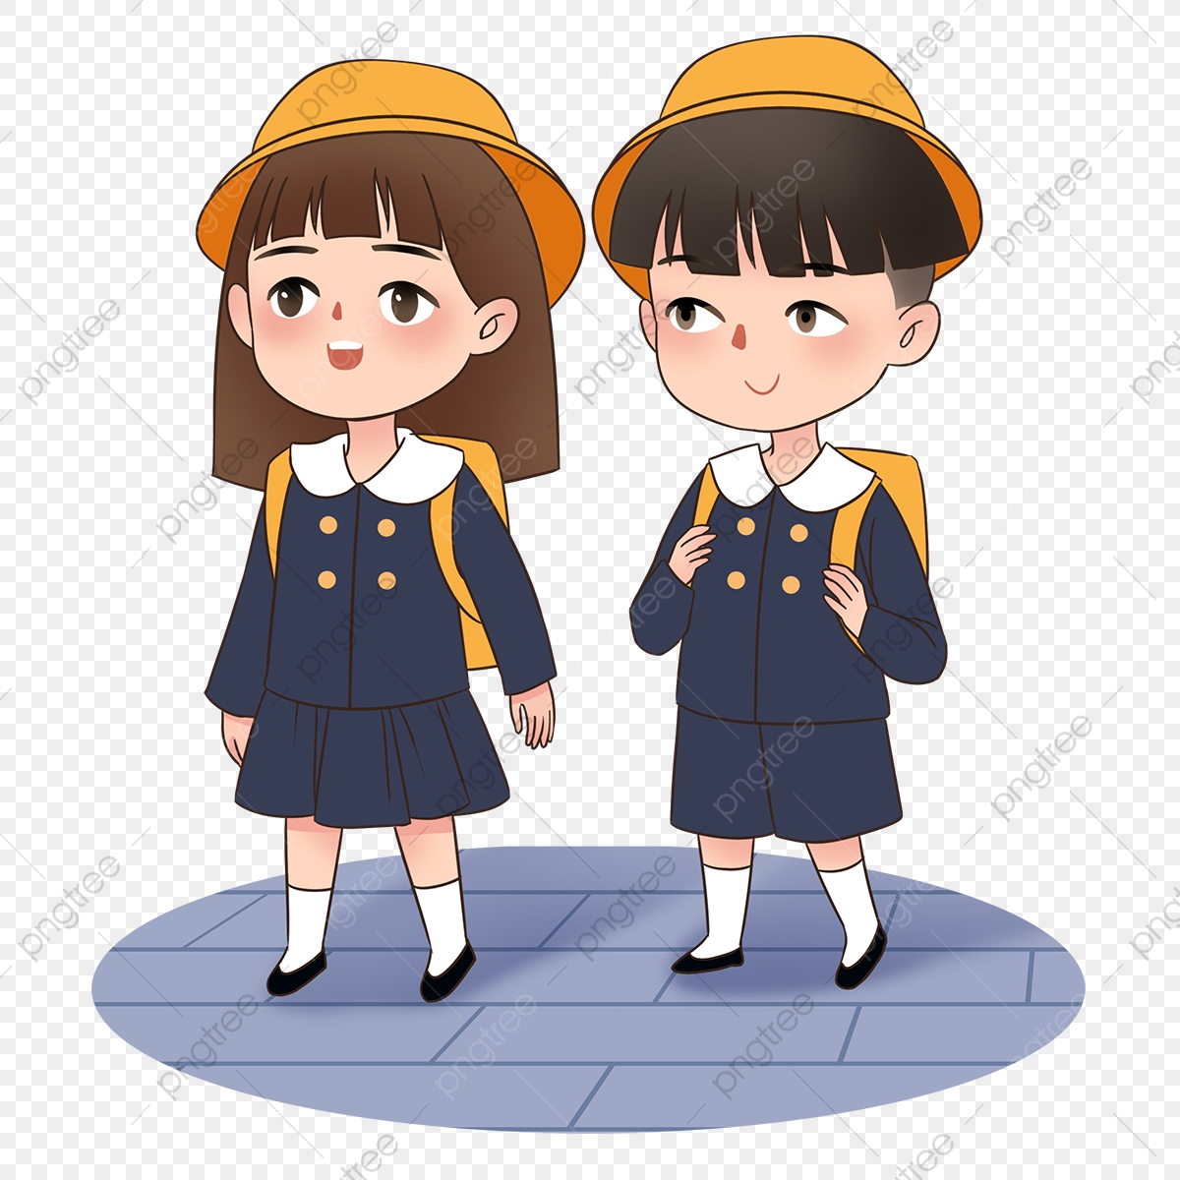
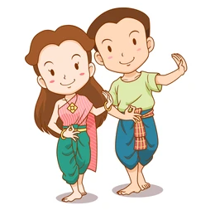
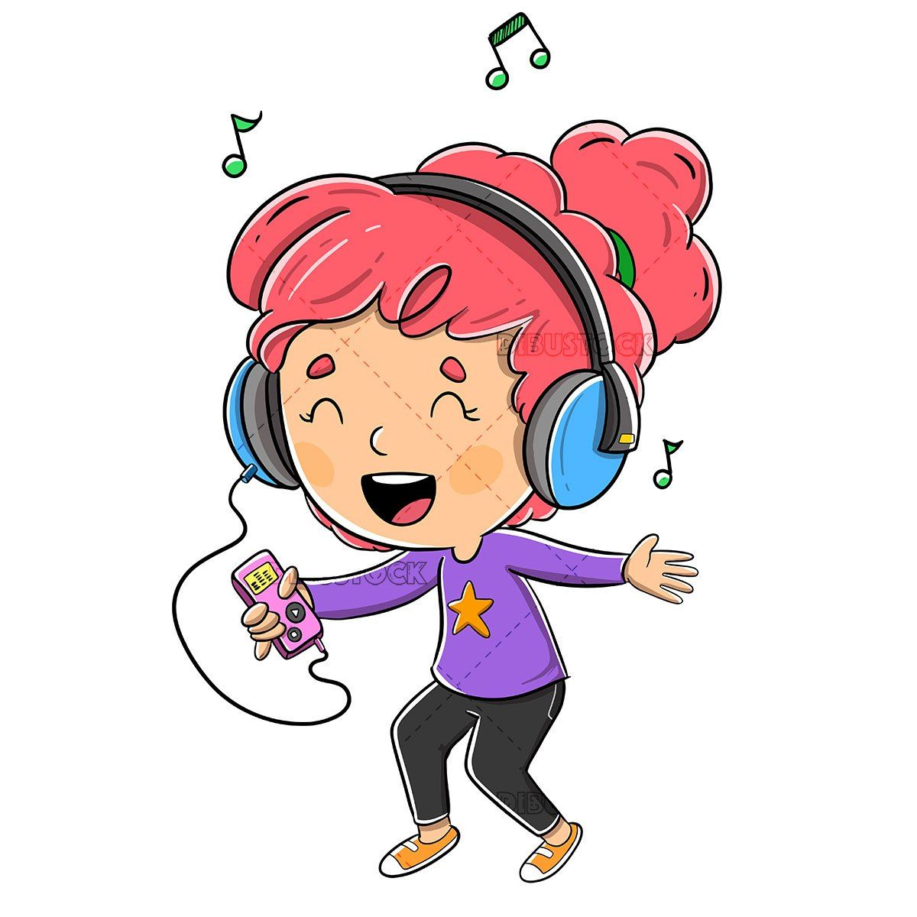
EXERCISE 4: Work in groups
1. Do you wear a school uniform?
2. Do you do traditional dancing?
3. Would you like time to listen to music during the day?

Slide 11

Do you like your school?
Is your school big or small?
How are the teachers/ the students/the classmates there?
Is it nice?
How many classrooms are there in your school?
How many floors are there in your school?

Slide 12



- Learn by heart all the new words
- Prepare for next lesson – Language focus - Present continuous tense: Affirmative and negative.

